Slide 1


OCCUPY YOUR CITY. MeetForFree

Slide 2
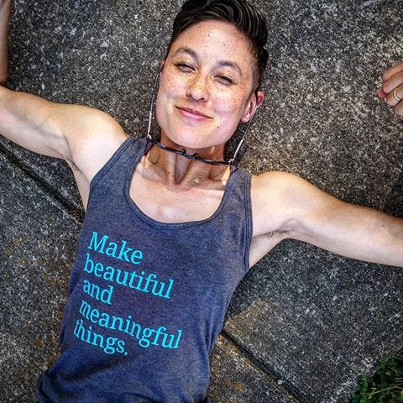


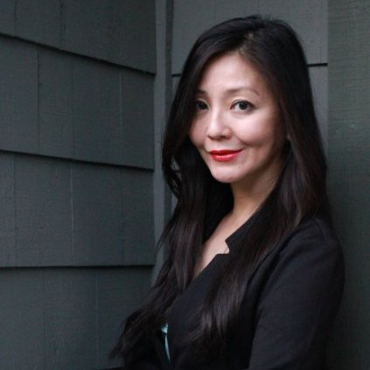
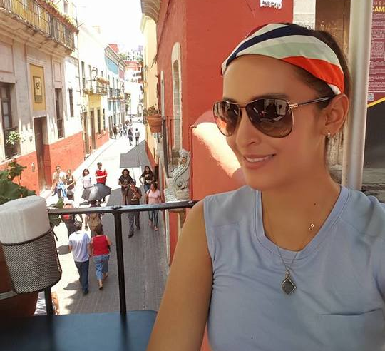

THE TEAM
DOM
Stylesheets, views, Gitmaster, Responsive Design
EVLYN
Back-End database, environment set up, setting up server
LAURA
API Integration,
JavaScript
SUAN
Data Cleaning
CYNTHIA
Research on content
LUCIANA
Wireframes, UI/UX,
Brand Identity

Slide 3
PROBLEM STATEMENT

Slide 4
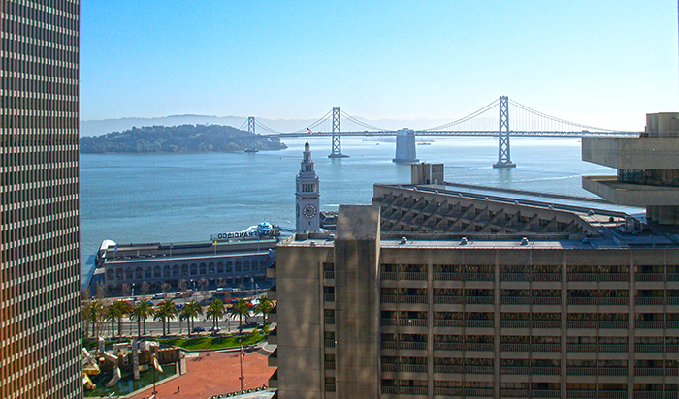
OUR GOAL

Slide 5








TECH STACK
API

Slide 6
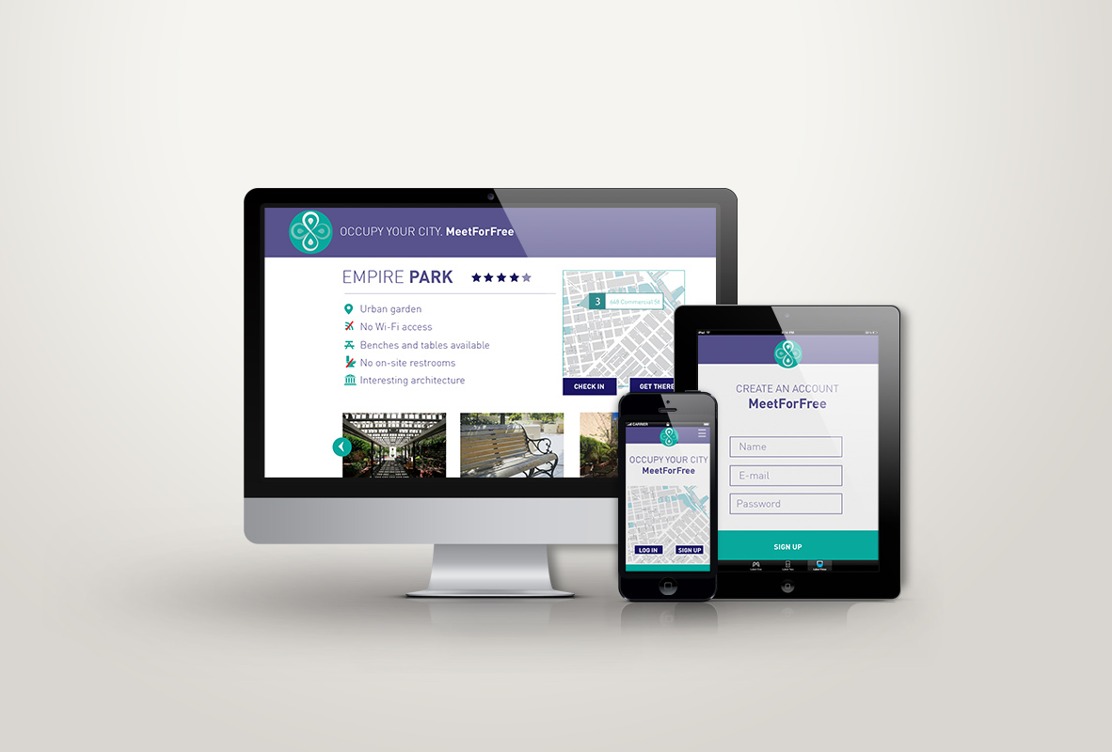
RESPONSIVE DESIGN

Slide 7
UX UI

Slide 8
UX UI

Slide 9
UX UI

Slide 10
UX UI

Slide 11
UX UI

Slide 12
UX UI

Slide 13
UX UI

Slide 14
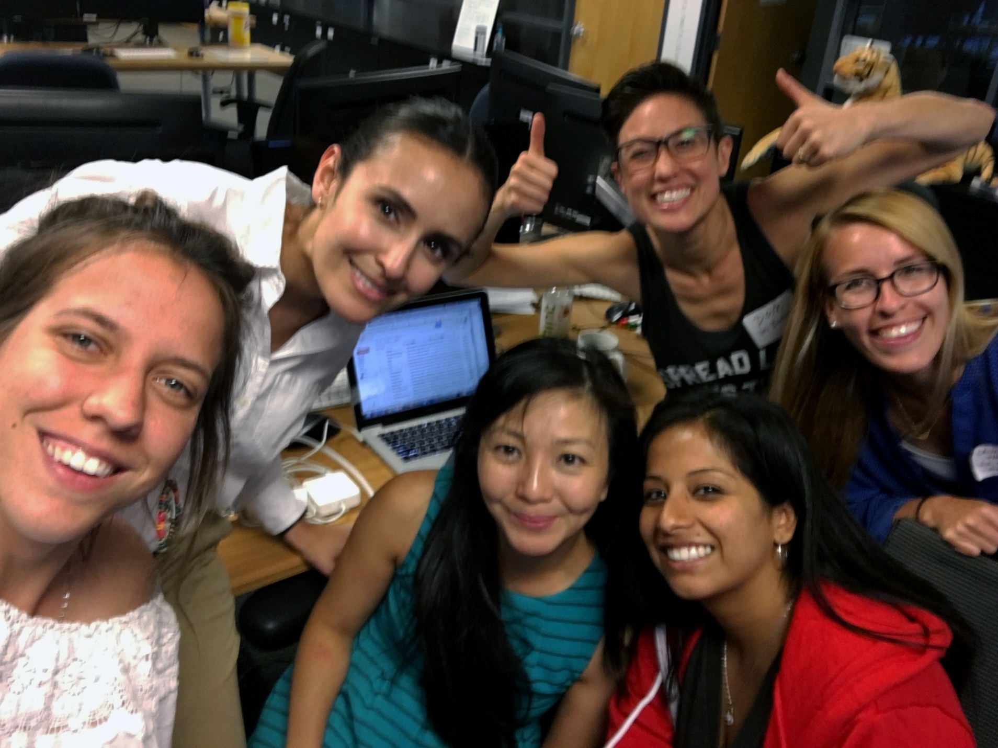
THANK YOU! MeetForFree

